Slide 1


Strategic
Orientations on
Water and Climate Change
July 2022
Notes:
1

Slide 2
Need and objectives
Article 19.2 of Law 7/2021, of May 20, on climate change and energy transition, states the need to develop a Water Strategy for the Ecological Transition.
Goals
Define the guidelines and measures that should be considered in the planning and management of water in our country
Adapt the existing water management system to the impacts of climate change by increasing the system’s resilience
The 2030 Agenda :
How to ensure water security ,
Achieve the environmental objectives linked to water
c) Promote the social aspects of sustainable development .

Slide 3
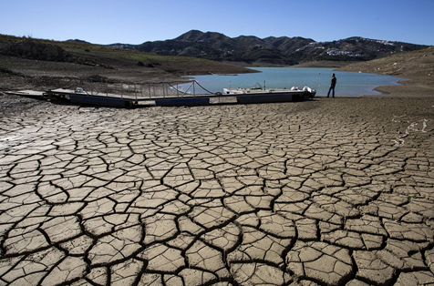
Adaptation to climate change
The Mediterranean region is especially sensitive to the impacts of climate change (IPPC, 2021).
There is a high probability of a decline in water resources, more pronounced in the arid and semi-arid areas of our country.
Scenario : less available water, with more flood and drought episodes.
The water management system must be endowed with adequate resilience:
  Demand management
  Efficient use of the resource
  Integration of non-conventional water resources: reuse and desalination
  Environmental recovery of water masses

Slide 4
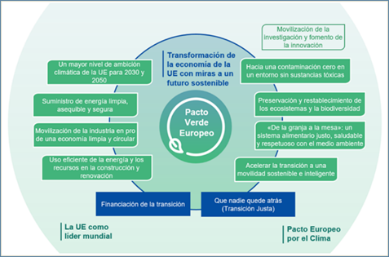
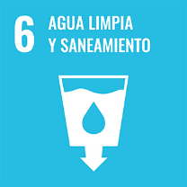


Water Policies and Strategies’ Framework
European Green Deal
EU Biodiversity Strategy 2030
UN 2030 Agenda for Sustainable Development
Spanish Circular Economy Strategy
National Plan for Adaptation to Climate Change 2021-2030

Slide 5
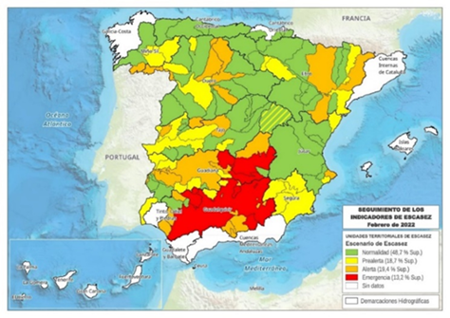
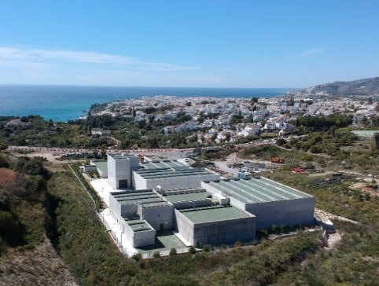
Spain’s challenges in water management to address climate change
Fragile balance between available resources and water demands, aggravated by climate change.
Highest water exploitation indices in Europe. More frequent droughts.
Almost 500 urban agglomerations do not comply with EU requirements regarding wastewater treatment.
New obligations derived from the Review of Directive 91/271/EEC on the treatment of urban wastewater.

Slide 6
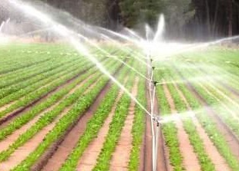
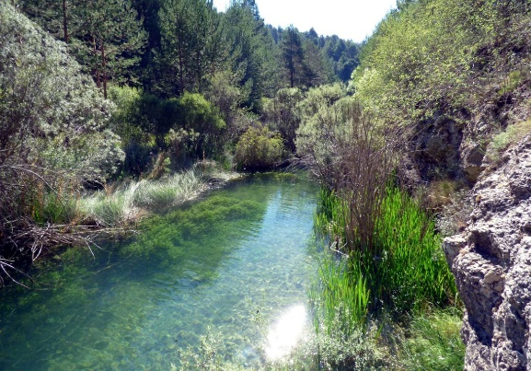
Challenges in water management to face climate change
Environmental recovery of groundwater masses.
  Overexploitation of aquifers due to intensive use
  Diffuse contamination by nitrates
Presence of pesticides in the water.
Hydromorphological alterations of rivers. Loss of biodiversity and ecosystem’s services.

Slide 7
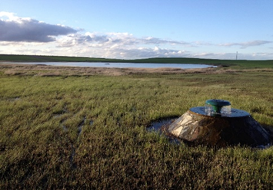
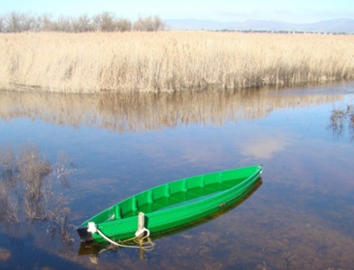
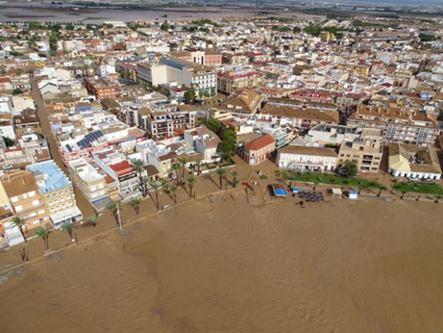
Lines of action to address the challenges
Transpose regulatory framework and EU policies.
Hydrological Planning in a context of adaptation to climate change.
Recover, restore and protect rivers, lakes, aquifers and wetlands.
Increase water security.
Advance in sanitation and water treatment.
Fight against diffuse pollution.
Advance in flood risk management.

Slide 8
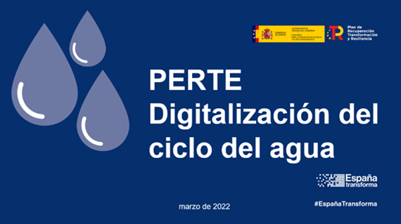
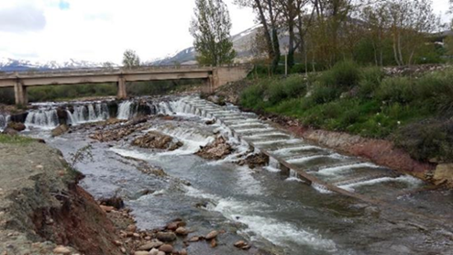
Lines of action to address the challenges
Advance in drought risk management.
Innovate, research and apply new technologies. Digitization.
Promote sustainable economic activities.
Strengthen financing.
Build a transparent, equitable and participatory water governance model.
Promote the international water agenda.

Slide 9
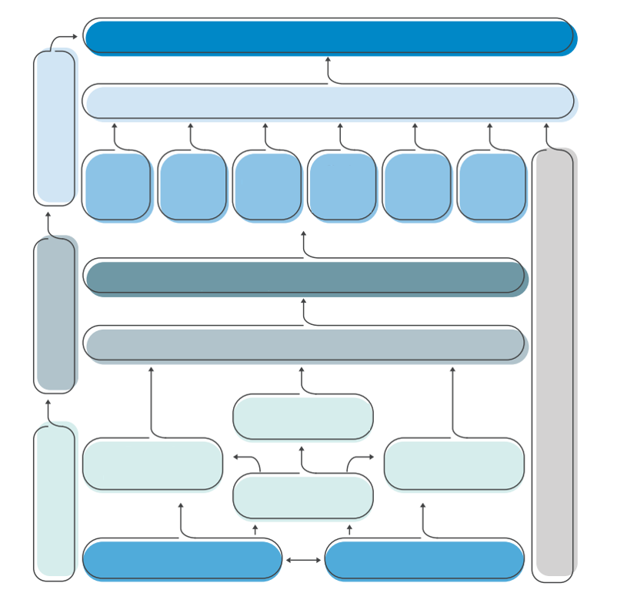
Instruments of the Strategy
Achievement of environmental objectives and water security
Hydrological plans and programs of actions
Planning assets
Special
Drought
Plans
Flood risk
management
plans
River
Restoration
Strategy
Wetland
Recovery
Plan
Groundwater
Action
Plan
Wastewater
treatment
and Reuse
Plan
Transparency and public participation Strategy
Compliance: quality focused on the citizen
Strategy assets
Adequacy of the legal and governance framework
Promote the international agenda on water
Climate Change Adaptation
2021-2030 National Plan
Financing and
cost recovery
Strategy
Technology: digitization
innovation
Support Assets
Alignment with
European Green Deal
Reinforcement of human capital
Capacity Development

Slide 10
Main Instruments of the Strategy (I)
Instruments | Expected approval date | Main impacts | Investment estimate (€)
Basin management plans | 4th Q 2022 | Recovery of 1,500 surface water masses and 300 groundwater masses (by 2027) | €34,000 M for all Public Administrations throughout Spain. €10,000 M allocated from National Budget
 |  | Significant improvement in water security in 50 exploitation systems out of a total of 150.
National River Restoration Strategy | 4th Q 2022 | More than 100 river restoration projects | 2,500 M€ AGE (by 2030)
 |  | 3,000 km of rivers restored (by 2030)
Flood Risk Management Plans | 4th Q 2022 | Reduction of risk for 3 million people through alert systems, protection against floods and solutions based on nature (by 2027) | €3,600 M Public Administration €10,000 M allocated from National Budget
Special Drought Plans | 2nd Q 2023 | Optimize water management in periods of drought, minimizing economic, social and environmental impacts | No required investment, mainly management measures

Slide 11
Main Instruments of the Strategy (II)
Instruments | Expected approval date | Main impacts | Investment estimate (€)
Groundwater Action Plan | 4th Q 2022 | Improve knowledge by 400 masses. 1,000 new control points, 250 new protection perimeters and 100 numerical simulation models for masses at risk. | 500 M€ allocated from National Budget (by 2030)
DSEAR Plan-Depuration, Sanitation, Efficiency, Savings and Reuse | Approved July 2021 | Conformity of some 400 urban settlements in infringement procedures of the European Directive | Governance instrument. Investments included in hydrological plans of the order of €3,500 M AGE
PERTE Digitization of the Water Cycle | Approved March 2022 | Improves water use efficiency | 2,000 M€ allocated from National Budget 1,000 M€ from other Public Administrations and the private sector
 |  | Digitization Basin Organizations
 |  | Digital supply systems in towns >20,000
 |  | Availability of information on water uses
 |  | Creation of the water cycle observatory
 |  | 3,500 new jobs

Slide 12
Main Instruments of the Strategy (III)
Instruments | Expected approval date | Main impacts | Investment estimate (€)
Modification of the Water Law and Regulations | 2nd Q 2023 | Water Law with a clearer and more structured text that will solve numerous problems in water management, focusing on environmental protection and water safety and seeking a more agile and modern water administration.
 |  | Includes the modification of the economic and financial regime to enhance cost recovery of costs from users

Slide 13
Main Instruments of the Strategy (III)
Instruments | Expected approval date | Main impacts | Investment estimate (€)
Modification of the Water Law and Regulations | 2nd Q 2023 | Water Law with a clearer and more structured text that will solve numerous problems in water management, focusing on environmental protection and water safety and seeking a more agile and modern water administration.
 |  | Includes the modification of the economic and financial regime to enhance cost recovery of costs from users

Slide 14


Digital versions available
Executive summary
Full document

Slide 15
Strategic Orientations on Water and Climate Change
July 2022
Notes:
15

